Slide 1

Predictive Learning from Data
LECTURE SET 9-1
Margin-Based Methods and Support Vector Machines
Electrical and Computer Engineering

Slide 2
OUTLINE
Motivation
Margin-based loss
SVM for classification
SVM classification: examples
Support Vector Regression
SVM and regularization
Summary
Note: presentation follows Ch. 9 (Cherkassky & Mulier, 2007)

Slide 3
Motivation for Nonlinear Methods
Predictive learning algorithm is proposed using ‘reasonable’ heuristic arguments.
reasonable ~ statistical or biological
2. Empirical validation + improvement
Statistical explanation (why it really works)
Examples: CART, MARS, neural nets, AdaBoost
In contrast, SVM methodology was originally introduced and motivated in VC-theory.

Slide 4
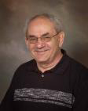
SVM: Brief History
Margin (Vapnik & Lerner)
Margin (Vapnik and Chervonenkis, 1964)
1964 RBF Kernels (Aizerman)
1965 Optimization formulation (Mangasarian)
1971 Kernels (Kimeldorf annd Wahba)
1992-1994 SVMs (Vapnik et al)
1996 – present Rapid growth, numerous apps
1996 – present Extensions to advanced settings

Slide 5
Growing Popularity of SVMs
GOOGLE search on SVM
→ 5.5 mln results
GOOGLE search on Kernel Methods
→ 4.6 mln results
GOOGLE search on CART
→ 5 mln results
GOOGLE search on Multilayer Perceptrons
→ 0.9 mln results
BUT plenty of conceptual misunderstanding

Slide 6
MOTIVATION for SVM
Recall ‘conventional’ methods:
- model complexity ~ dimensionality (# features)
- nonlinear methods → multiple minima
- hard to control complexity
‘Good’ learning method:
(a) tractable optimization formulation
(b) tractable complexity control(1-2 parameters)
(c) flexible nonlinear parameterization
Properties (a), (b) hold for ‘linear methods’
SVM solution approach

Slide 7
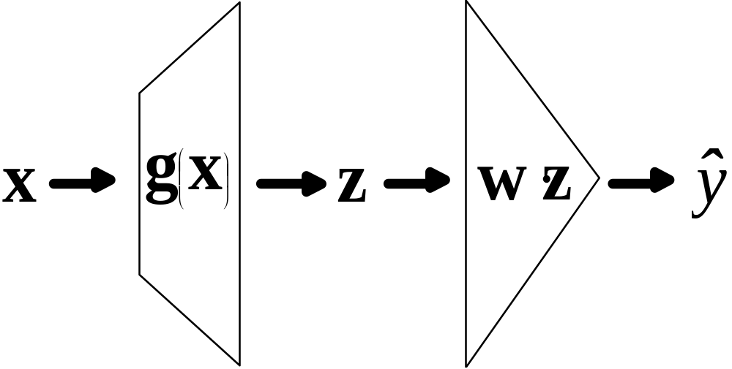
SVM Approach
Linear approximation in Z-space using special adaptive loss function
Complexity is independent of dimensionality

Slide 8
OUTLINE
Motivation
Margin-based loss
- Example: binary classification
- Philosophical motivation
- Loss functions for classification
- VC-theoretical motivation
SVM for classification
SVM classification: examples
Support Vector Regression
SVM and regularization
Summary

Slide 9
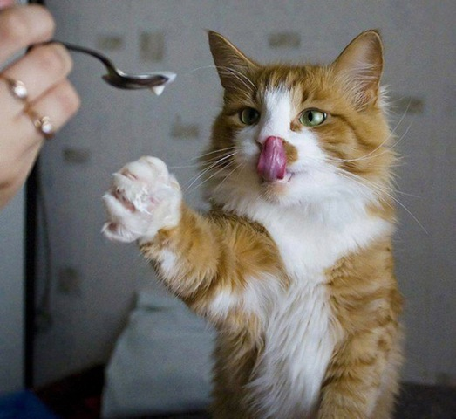
Importance of Reward/ Punishment
Loss function (problem-specific) can be used
to control model complexity (generalization)

Slide 10
Main Idea
Model complexity is controlled by special loss function used for fitting training data
Such empirical loss functions may be different from the loss functions used for learning problem setting
Such loss functions are adaptive, i.e. can adapt their complexity to given data set
Different loss functions for different learning problems (classification, regression etc.)
Model complexity (VC-dim.) is controlled independently of the number of features

Slide 11
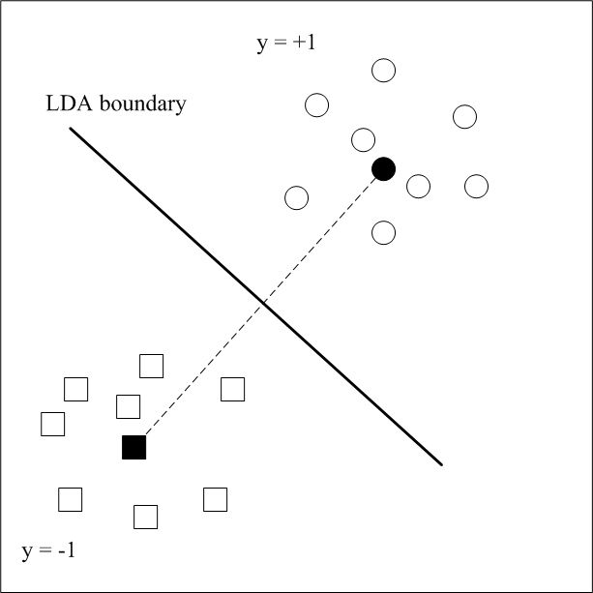
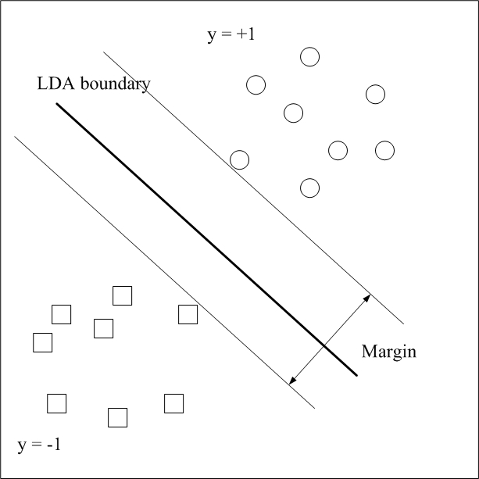
Example: binary classification
LDA solution Separation margin

Slide 12
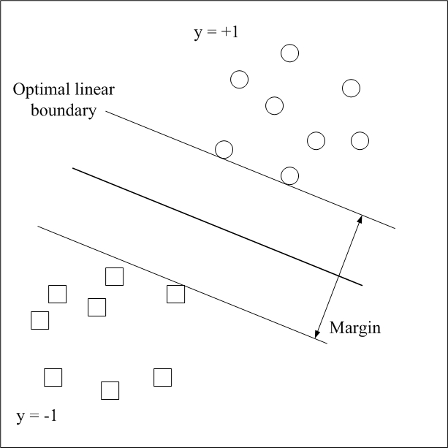

Largest-margin linear model
Many solutions explain the data well (zero error)
All solutions ~ the same linear parameterization
Larger margin ~ more confidence (falsifiability)

Slide 13
Philosophical Motivation
Classical view: good model
explains the data + low complexity
Occam’s razor (complexity ~ # parameters)
VC theory: good model
explains the data + low VC-dimension
~ VC-falsifiability: good model
explains the data + has large falsifiability
The idea: falsifiability ~ empirical loss function

Slide 14
Adaptive loss functions
Both goals (explanation + falsifiability) can encoded into empirical loss function where
- (large) portion of the data has zero loss
- the rest of the data has non-zero loss, i.e. this data falsifies the model
The trade-off (between the two goals) is adaptively controlled → adaptive loss function
Example of such adaptive loss function for classification problem is shown next

Slide 15


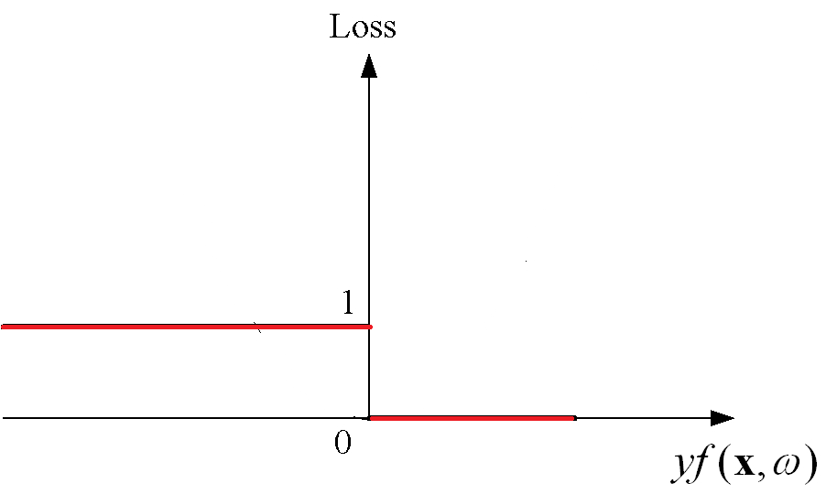
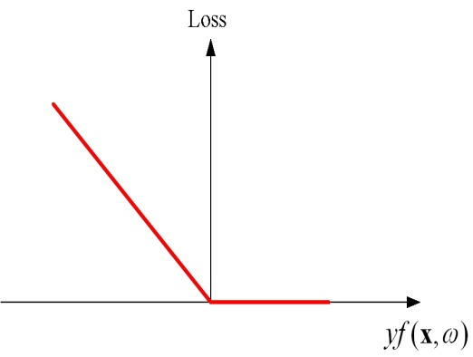
Loss Functions for Classification
Decision rule
Quantity is analogous to residuals in regression
Common loss functions: 0/1 loss and linear loss
Properties of a good loss function?
~ continuous + convex + robust

Slide 16
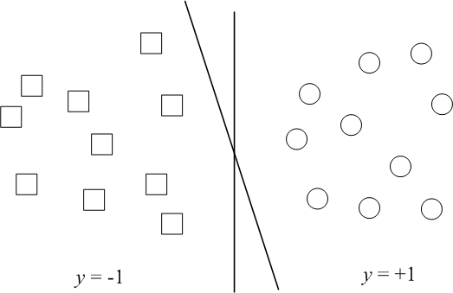
Motivation for margin-based loss
Given: Linearly separable data
How to construct linear decision boundary?
(a) Many linear decision boundaries (that have no errors)

Slide 17
Largest-margin solution
All linear models explain training data (~ zero error)
All solutions ~ the same linear parameterization
Larger margin ~ more confidence (larger falsifiability)

Slide 18
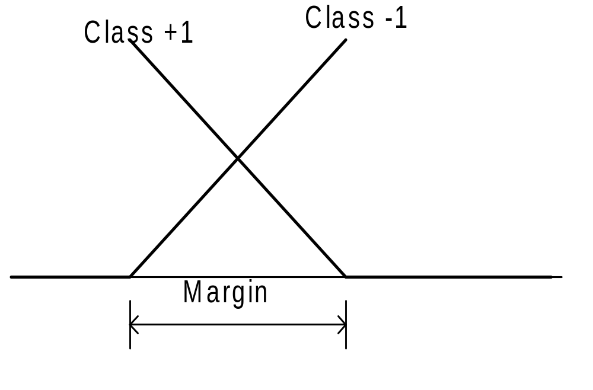

Margin-based loss for classification: margin size is adapted to training data

Slide 19
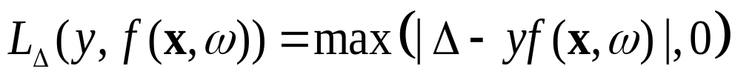

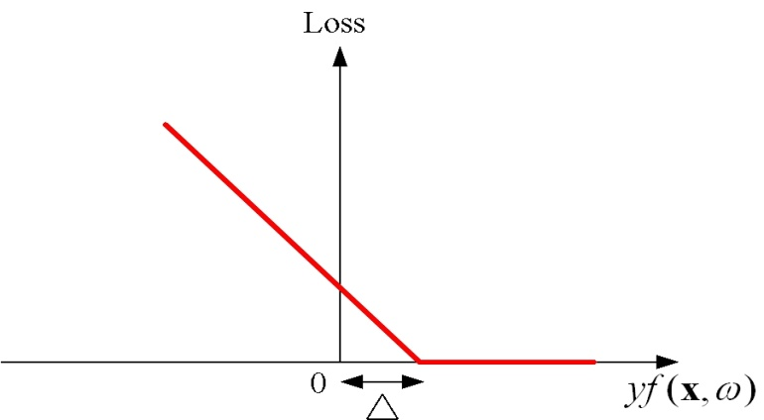




Margin-based loss for classification
SVM loss or hinge loss
Minimization of slack variables

Slide 20
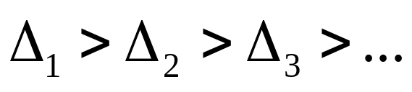
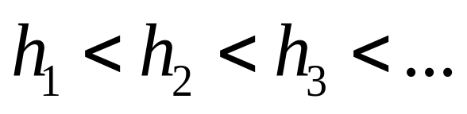
Margin based complexity control
Large degree of falsifiability is achieved by
- large margin (for classification)
Explanation of training data is achieved by
- minimization of (sum of) slack variables
For linear classifiers:
larger margin → smaller VC-dimension
~

Slide 21
VC-theoretical Motivation
SVM model complexity (~ VC-dimension)
New implementation of SRM using VC-bounds
Adaptive margin loss functions for other types of learning problems:
- for regression
- for single-class learning

Slide 22

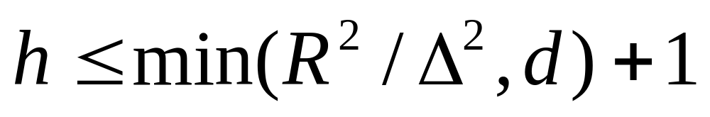
Complexity of -margin hyperplanes
If data samples belong to a sphere of radius R, then the set of -margin hyperplanes has VC dimension bounded by
For large margin hyperplanes, VC-dimension controlled independent of dimensionality d.

Slide 23
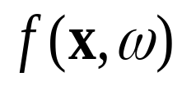

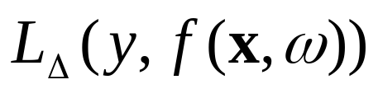

SVM Model Complexity
Two ways to control model complexity
-via model parameterization
  using fixed loss function:
-via adaptive loss function:
  using fixed (linear) parameterization
~ Two types of SRM structures (next slide)

Slide 24


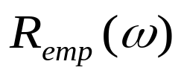

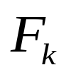
VC Generalization Bound and SRM
Classification: the following bound holds with probability of for all approximating functions
Two general strategies for implementing SRM:
1. Keep fixed and minimize
(most statistical and neural network methods)
2. Keep fixed (small) and minimize
larger margin → smaller VC-dimension
Equivalence classes on a set of possible models:
- for each class select the largest-margin hyperplane

Slide 25
Margin based complexity control
Large degree of falsifiability is achieved by
- large margin (classification)
- small epsilon (regression)
- radius of a sphere (single-class learning)
Margin-based methods control complexity independent of problem dimensionality
The same idea can be used for other types of learning problems

Slide 26
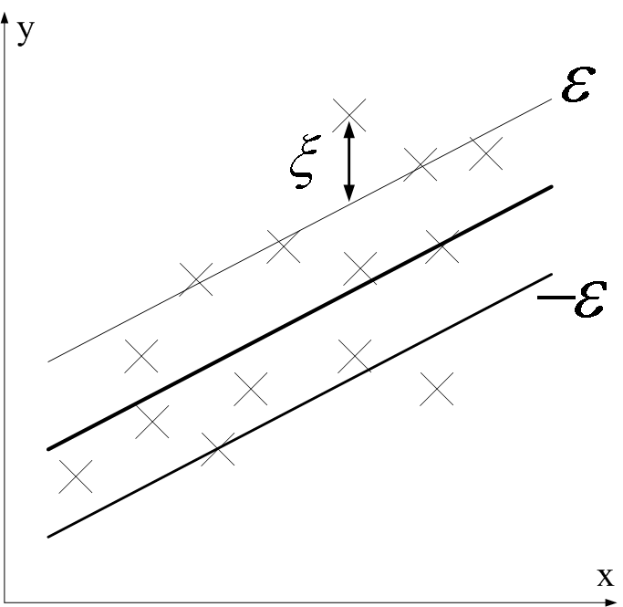
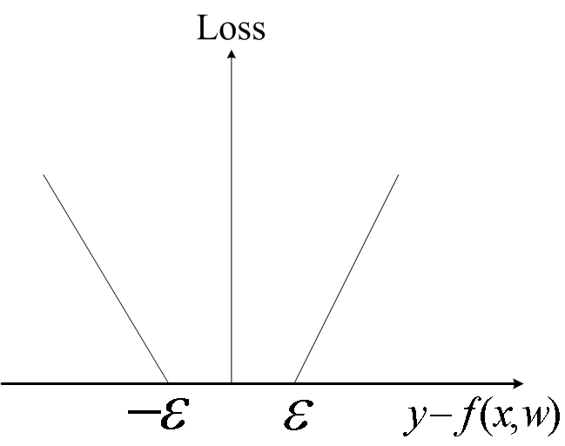
Epsilon loss for regression

Slide 27


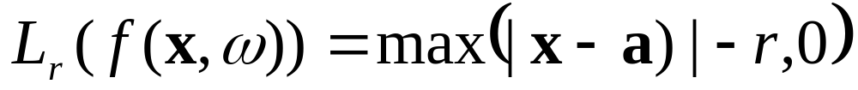
Single Class Learning
Boundary is specified by a hypersphere with center a and radius r.
An optimal model minimizes the volume of the sphere and the total distance of the data points outside the sphere

Slide 28


Margin-based loss: summary
Classification:
falsifiability controlled by margin
Regression:
falsifiability controlled by
Single class learning:
falsifiability controlled by radius r
NOTE: the same interpretation/ motivation for margin-based loss for different types of learning problems.

Slide 29
OUTLINE
Motivation
Margin-based loss
SVM for classification
- Linear SVM classifier
- Inner product kernels
- Nonlinear SVM classifier
SVM classification: examples
Support Vector Regression
SVM and regularization
Summary

Slide 30
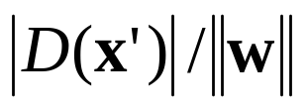
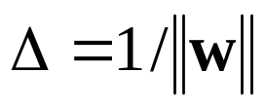
Optimal Separating Hyperplane
D
(
x
)
>
+
1
1
w
(
)
D
(
x
)
=
+
1
D
x
′
w
D
(
x
)
<
−
1
D
(
x
)
=
0
x
′
D
(
x
)
=
−
1
Distance btwn hyperplane and sample
→ Margin Shaded points are SVs

Slide 31
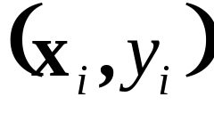
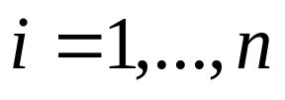


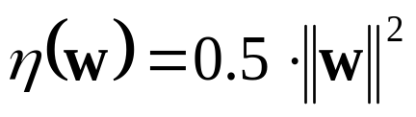

Optimization Formulation
Given training data
Find parameters of linear hyperplane
that minimize ~ max
under constraints
Quadratic optimization with linear constraints
tractable for moderate dimensions d
For large dimensions use dual formulation:
- scales with n rather than d
- uses only dot products

Slide 32


From Optimization Theory:
For a given convex minimization problem with convex inequality constraints there exists an equivalent dual unconstrained maximization formulation with nonnegative Lagrange multipliers
Karush-Kuhn-Tucker (KKT) conditions:
Lagrange coefficients only for samples that satisfy the original constraint
with equality
~ SV’s have positive Lagrange coefficients

Slide 33
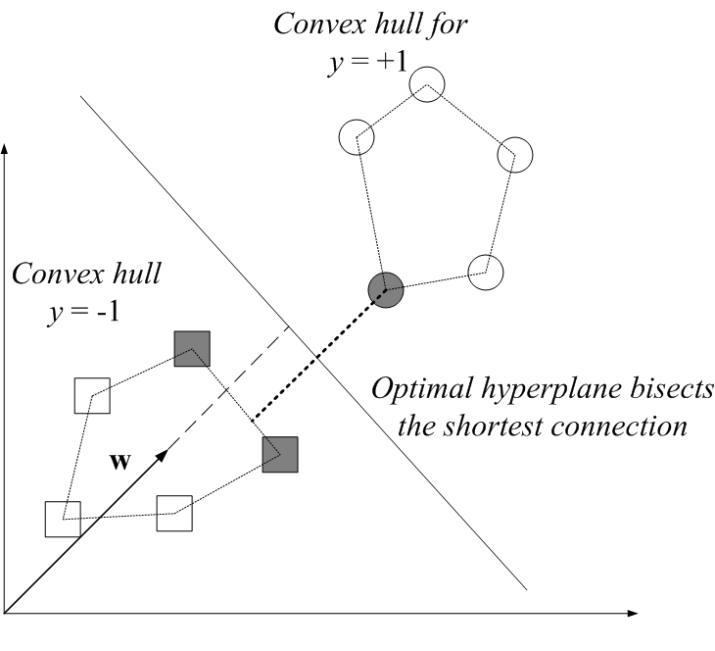
Convex Hull Interpretation of Dual
Find convex hulls for each class. The closest points to an optimal hyperplane are support vectors

Slide 34
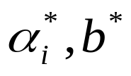
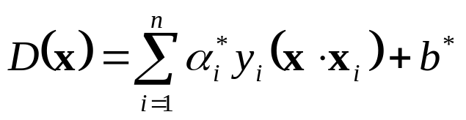
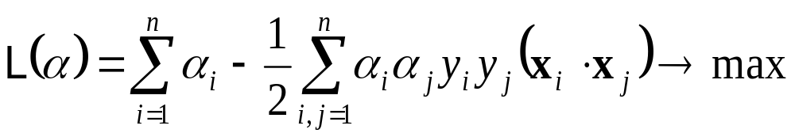
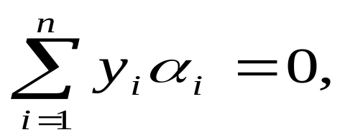


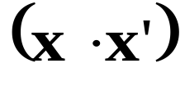
Dual Optimization Formulation
Given training data
Find parameters of an opt. hyperplane
as a solution to maximization problem
under constraints
Note: data samples with nonzero are SVs
Formulation requires only inner products

Slide 35
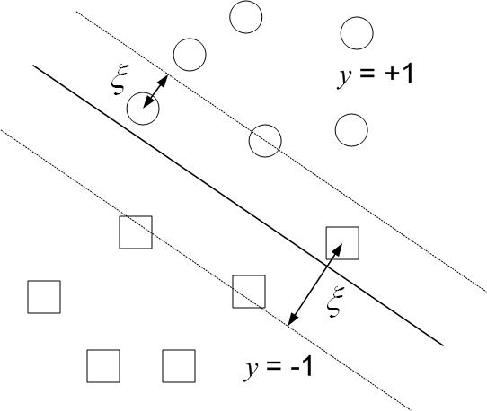
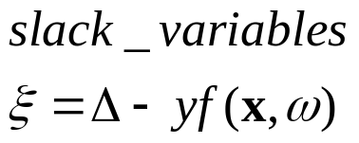
Classification: non-separable data

Slide 36
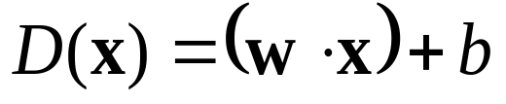
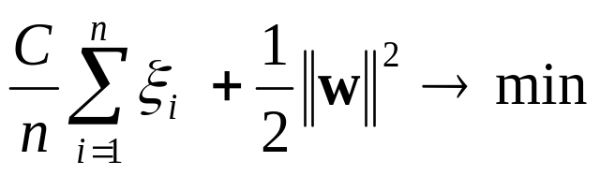
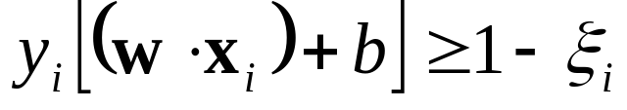
SVM for non-separable data
ξ
=
1
−
D
(
x
)
1
1
x
1
ξ
=
1
−
D
(
x
)
2
2
x
2
)
x
D
(
x
=
+
1
3
D
(
x
)
=
0
ξ
=
1
+
D
(
x
)
3
3
D
(
x
)
=
−
1
Minimize
under constraints

Slide 37
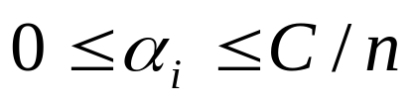

SVM Dual Formulation
Given training data
Find parameters of an opt. hyperplane
as a solution to maximization problem
under constraints
Note: data samples with nonzero are SVs:
free/unbounded and bounded SVs
Formulation requires only inner products

Slide 38
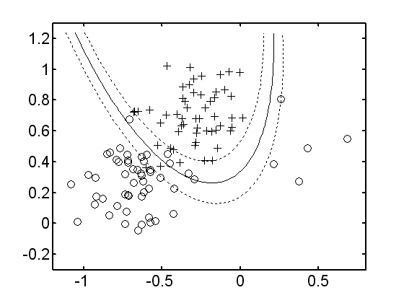
Nonlinear Decision Boundary
Fixed (linear) parameterization is too rigid
Nonlinear curved margin may yield larger margin (falsifiability) and lower error

Slide 39
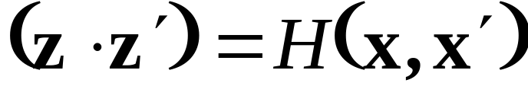

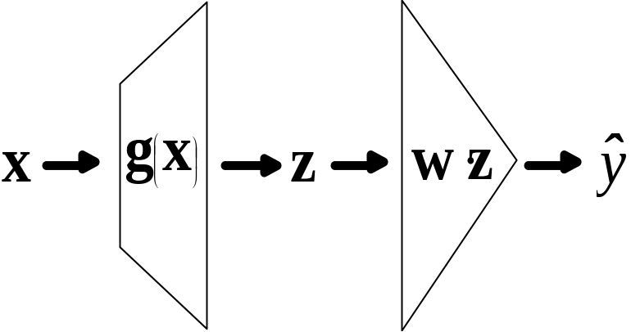
Nonlinear Mapping via Kernels
Nonlinear f(x,w) + margin-based loss = SVM
Nonlinear mapping to feature z space, i.e.
Linear in z-space=nonlinear in x-space
BUT ~ kernel trick
→ Compute dot product via kernel analytically

Slide 40
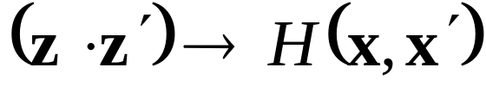
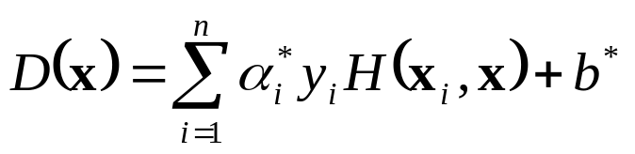
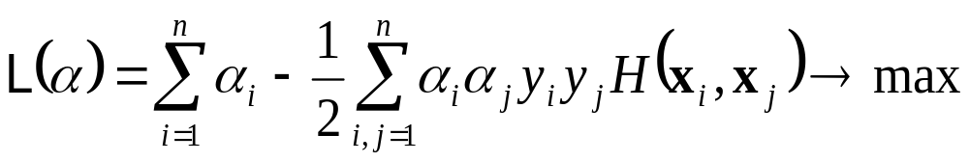
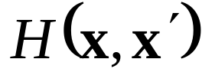
SVM Formulation (with kernels)
Replacing leads to:
Find parameters of an optimal hyperplane
as a solution to maximization problem
under constraints
Given: the training data
an inner product kernel
regularization parameter C

Slide 41
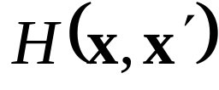
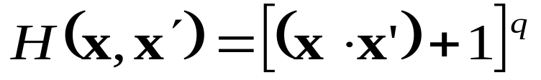
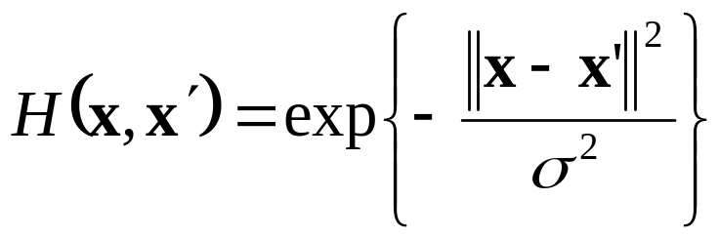
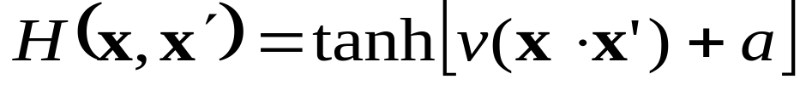

Examples of Kernels
Kernel is a symmetric function satisfying general (Mercer’s) conditions
Examples of kernels for different mappings x→z
Polynomials of degree q
RBF kernel
Neural Networks
for given parameters
Automatic selection of the number of hidden units (SV’s)

Slide 42
More on Kernels
The kernel matrix has all info (data + kernel)
H(1,1) H(1,2)…….H(1,n)
H(2,1) H(2,2)…….H(2,n)
………………………….
H(n,1) H(n,2)…….H(n,n)
Kernel defines a distance in some feature space (aka kernel-induced feature space)
Kernels can incorporate apriori knowledge
Kernels can be defined over complex structures (trees, sequences, sets etc)

Slide 43
Kernel Terminology
The term kernel is used in 3 contexts:
- nonparametric density estimation
- equivalent kernel representation for linear least squares regression
- SVM kernels
SVMs are often called kernel methods
Kernel trick can be used with any classical linear method, to yield a nonlinear method:
For example, ridge regression + kernel→ LS SVM

Slide 44
Support Vectors
SV’s ~ training samples with non-zero loss
SV’s are samples that falsify the model
The model depends only on SVs
→ SV’s ~ robust characterization of the data
WSJ Feb 27, 2004:
About 40% of us (Americans) will vote for a Democrat, even if the candidate is Genghis Khan. About 40% will vote for a Republican, even if the candidate is Attila the Han. This means that the election is left in the hands of one-fifth of the voters.
SVM generalization ~ data compression

Slide 45
New insights provided by SVM
Why linear classifiers can generalize?
(1) Margin is large (relative to R)
(2) % of SV’s is small
(3) ratio d/n is small
SVM offers an effective way to control complexity (via margin + kernel selection) i.e. implementing (1) or (2) or both
Tuning of at most 3 hyper-parameters
SVM classifier ‘implements’ many heuristics:
MLP networks, RBF networks …

Slide 46
OUTLINE
Motivation
Margin-based loss
SVM for classification
SVM classification: examples
Support Vector Regression
SVM and Regularization
Summary

Slide 47

RBF SVM for Ripley’s Data Set
  No. of Training samples = 250
  No. of Test samples = 1,000
Model selection via 10-fold cross-validation
Test error 9.8%
Notes:
Test data digit “5” 892 samples, digit “8” 974 samples.

Slide 48

Details of Model Selection
  RBF kernel
  Two tuning parameters: C and gamma (RBF parameter)
  Optimal values selected via 10-fold cross-validation
Note log scale for parameter values
gamma | C= 0.1 | C= 1 | C= 10 | C= 100 | C= 1000 | C= 10000
=2⁻³ | 98.4% | 23.6% | 18.8% | 20.4% | 18.4% | 14.4%
=2⁻² | 51.6% | 22% | 20% | 20% | 16% | 14%
=2⁻¹ | 33.2% | 19.6% | 18.8% | 15.6% | 13.6% | 14.8%
=2⁰ | 28% | 18% | 16.4% | 14% | 12.8% | 15.6%
=2¹ | 20.8% | 16.4% | 14% | 12.8% | 16% | 17.2%
=2² | 19.2% | 14.4% | 13.6% | 15.6% | 15.6% | 16%
=2³ | 15.6% | 14% | 15.6% | 16.4% | 18.4% | 18.4%
Notes:
Test data digit “5” 892 samples, digit “8” 974 samples.

Slide 49


IRIS Data Set
Modified Iris data set:
- two input variables, petal length and petal width
- two classes: iris versicolor (+) vs not_versicolor (Δ)
Two SVM models: polynomial kernel and RBF kernel

Slide 50
Many challenging applications
Mimic human recognition capabilities
- high-dimensional data
- content-based
- context-dependent
Example: read the sentence
Sceitnitss osbevred: it is nt inptrant how lteters are msspled isnide the word. It is ipmoratnt that the fisrt and lsat letetrs do not chngae, tehn the txet is itneprted corrcetly
SVM is suitable for sparse high-dimensional representations

Slide 51
Example SVM Applications
Handwritten digit recognition
Face detection in unrestricted images
Text/ document classification
Image classification and retrieval
…….

Slide 52
Handwritten Digit Recognition (mid-90’s)
Data set:
postal images (zip-code), segmented, cropped;
~ 7K training samples, and 2K test samples
Data encoding:
16x16 pixel image → 256-dim. vector
Original motivation: Compare SVM with custom MLP network (LeNet) designed for this application
Multi-class problem: one-vs-all approach
→ 10 SVM classifiers (one per each digit)

Slide 53
Digit Recognition Results
Summary
- prediction accuracy better than custom NN’s
- accuracy does not depend on the kernel type
- 100 – 400 support vectors per class (digit)
More details
Type of kernel No. of Support Vectors Error% Polynomial 274 4.0
RBF 291 4.1
Neural Network 254 4.2
~ 80-90% of SV’s coincide (for different kernels)
Reduced-set SVM (Burges, 1996) ~ 15 per class

Slide 54
Face detection in images (Osuna, et al, 1997)
Goal: Detect and locate face(s) in an image
Training data: face and non-face 19X19 pixel images obtained from real data
Test: Set A 313 high-quality images with 1 face
Set B 23 mixed quality images ( multiple faces)
Preprocessing: illumination gradient correction, histogram equalization
Face Search Strategy: divide an image into overlapping sub-images, at multiple scales, and classify each sub-image using SVM
Multiple scales of the original image are used
→ 5 million sub-images (for Set A)

Slide 55


Face detection: results
SVM Classifier:
2-nd order polynomial
Performance Results
Detection rate False Alarm
Test Set A 97% 4%
Test Set B 74% 20%

Slide 56
Document Classification (Joachims, 1998)
The Problem: Classification of text documents in large data bases, for text indexing and retrieval
Traditional approach: human categorization (i.e. via feature selection) – relies on a good indexing scheme. This is time-consuming and costly
Predictive Learning Approach (SVM): construct a classifier using all possible features (words)
Document/ Text Representation:
individual words = input features (possibly weighted)
SVM performance:
  Very promising (~ 90% accuracy vs 80% by other classifiers)
  Most problems are linearly separable → use linear SVM

Slide 57
OUTLINE
Introduction and motivation
Margin-based loss
SVM for classification
SVM classification: examples
Support Vector Regression
SVM and regularization
Summary

Slide 58


Linear SVM regression
Assume linear parameterization
SVM regression functional:
where

Slide 59




Loss Functions for Regression
Small data set (4 samples):
Input samples uniform in [0, 1]
Loss functions: squared, least-modulus, SVM
Estimates shown: dotted, dashed, and dashed-dotted

Slide 60
Comparison of Loss Functions (cont’d)
Small data set (4 samples):
Input samples uniform in [0, 1]
MSE test error for 5 realizations of training data:
 | Squared loss | Least modulus loss | SVM loss with epsilon=0.6
1 | 0.024 | 0.134 | 0.067
2 | 0.128 | 0.075 | 0.063
3 | 0.920 | 0.274 | 0.041
4 | 0.035 | 0.053 | 0.032
5 | 0.111 | 0.027 | 0.005
Mean | 0.244 | 0.113 | 0.042
St. Deviation | 0.381 | 0.099 | 0.025

Slide 61







Direct Optimization Formulation
Given training data
Minimize
Under constraints

Slide 62

Connection to Hinge Loss
-insensitive loss ~ sum of two hinge loss functions with margin borders at +/-

Slide 63





Dual Formulation for SVM Regression
Given training data
And the values of
Find coefficients
which maximize
Under constraints

Slide 64


Example: regression using RBF kernel
RBF estimate (dashed line) using
SVM model uses only 6 SV’s (out of the 40 points)

Slide 65

Example: decomposition of RBF model
Weighted sum of 6 RBF kernel fcts gives the SVM model

Slide 66

Robustness of SVM regression
Solid curve: SVM estimate with the outlier
Dashed curve: SVM estimate without the outlier

Slide 67
OUTLINE
Motivation
Margin-based loss
SVM for classification
SVM classification: examples
Support Vector Regression
SVM and regularization
Summary

Slide 68


SVM and Regularization
SVM → implements risk minimization (SRM) approach ~ system imitation
Regularization → for ill-posed function interpolation problems ~ system identification
But their risk functionals ‘look similar’
Many claims:
SVM = special case of regularization

Slide 69
SVM and Regularization (cont’d)
Regularization/Penalization was developed under function approximation setting where only an asymptotic theory can be developed
Well-known / widely used for low-dimensional problems since 1960’s (~ splines)
Ripley (1996): Since splines are so useful in one dimension, they might appear to be the obvious methods in more. In fact, they appear to be restricted and little used.
Explanation: classical spline methods ignore the role of margin-based loss

Slide 70


Comparison for Classification
Linear SVM vs Penalized LDA – comparison is fair
Data Sets: small (20 samples per class) large (100 samples per class)

Slide 71
Comparison results: classification
Small sample size:
Linear SVM yields 0.5% - 1.1% error rate
Penalized LDA yields 2.8% - 3% error
Large sample size:
Linear SVM yields 0.4% - 1.1% error rate
Penalized LDA yields 1.1% - 2.2% error
Conclusion: margin based complexity control is better than regularization

Slide 72


Comparison for regression
Linear SVM vs linear ridge regression (RR)
Note: Linear SVM has 2 tunable parameters
Sparse Data Set:
30 noisy samples, using target function
corrupted with gaussian noise with
Complexity Control:
- for RR vary regularization parameter
- for SVM ~ epsilon and C parameters

Slide 73

Complexity control for ridge regression
Coefficient shrinkage for ridge regression

Slide 74

Complexity control for SVM
Coefficient shrinkage for SVM:
(a)Vary C (epsilon=0) (b)Vary epsilon(C=large)
2.5
w1
2
1.5
w2
1
Coefficients
0.5
w3
0
w4
-0.5
w5
-8
-6
-4
-2
0
2
4
6
8
Log(n/C)

Slide 75



Comparison: ridge regression vs SVM
Sparse setting: n=10, noise
Ridge regression: chosen by cross-validation
SV Regression:
C selected by cross-validation
Ave Risk (100 realizations): 0.44 (RR) vs 0.37 (SVM)

Slide 76
Summary
SVM solves the learning problem directly → different SVM formulations
Margin-based loss: robust + performs complexity control
Implementation of SRM: new type of structure
Nonlinear feature selection (~ SV’s): incorporated into model estimation

